Slide 1

SEO Navigator: From Audit to Action.
Guttameedi Manasa

Slide 2
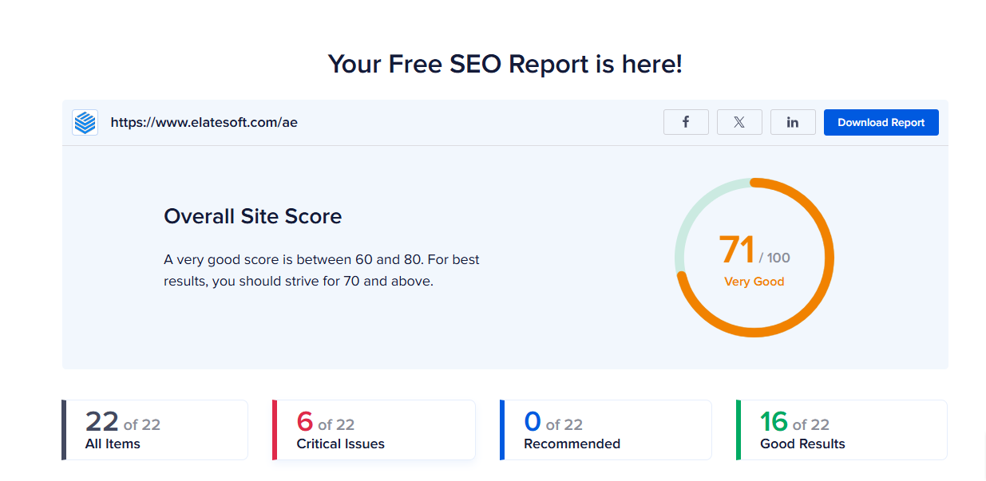
SEO Audit Report.
Selected website - Elat esoft (https://www.elatesoft.com/ae/)

Slide 3
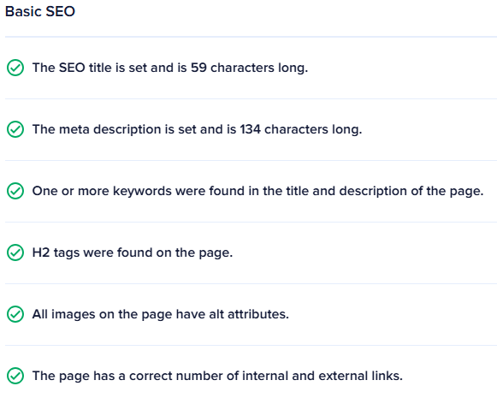
Strengths

Slide 4
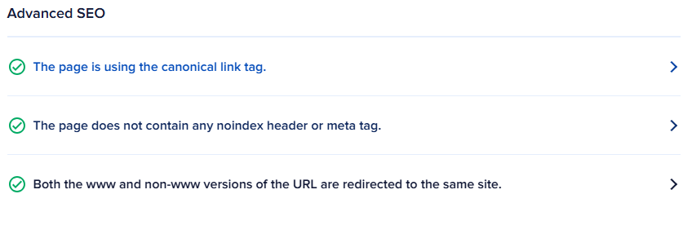
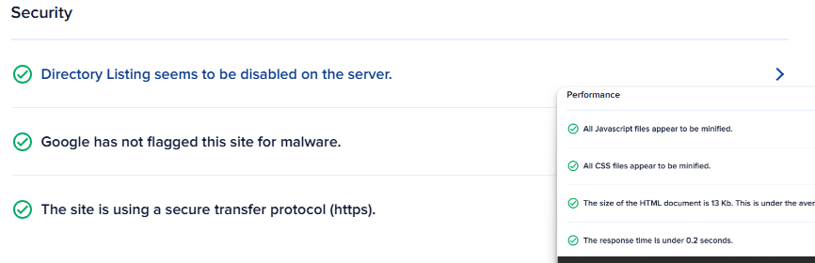

Slide 5
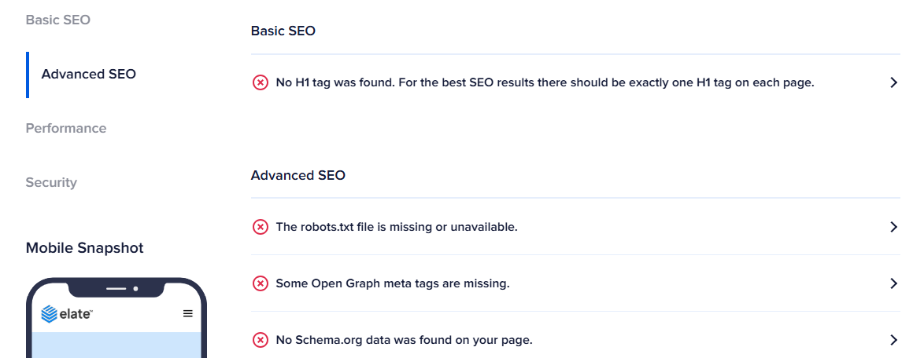
Weakness

Slide 6
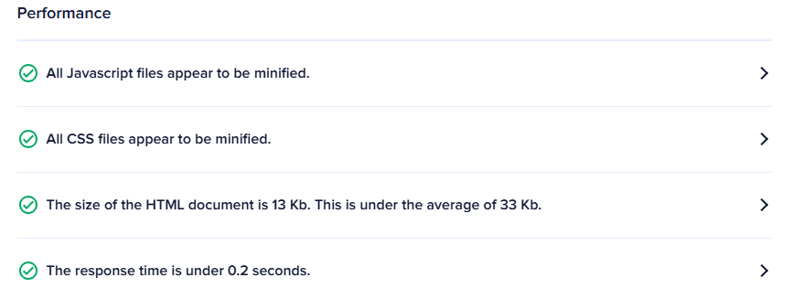
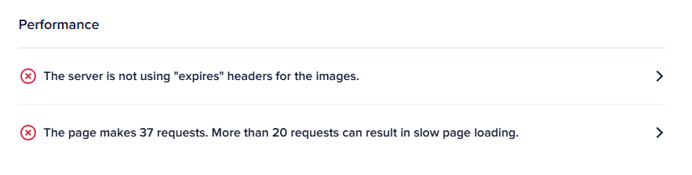
Performance

Slide 7
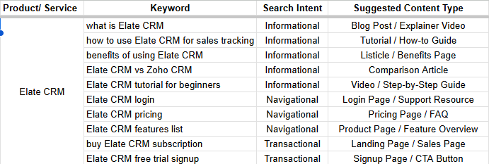
Keyword research report.

Slide 8
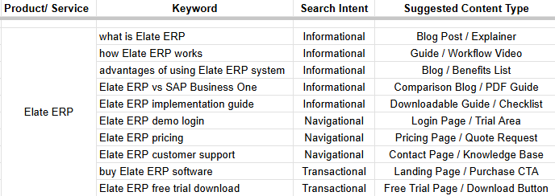

Slide 9
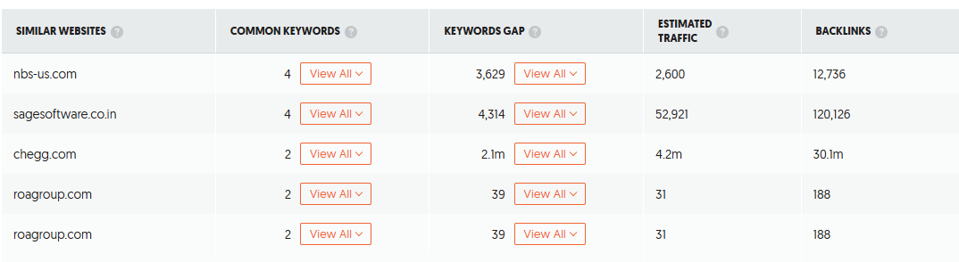
Competitor keyword analysis and insights.

Slide 10
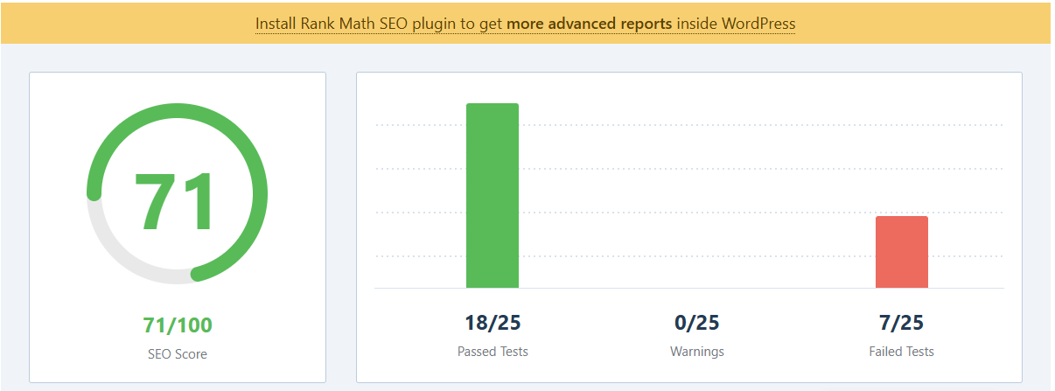
On Page SEO Audit Report.
Accounting Page - https://www.elatesoft.com/ae/accounting-software/

Slide 11



Slide 12
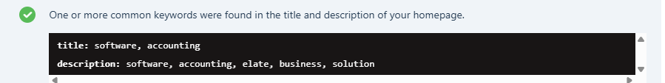
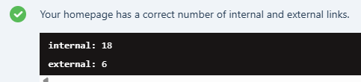



Slide 13

Contact Page - https://www.elatesoft.com/ae/contact-us/

Slide 14

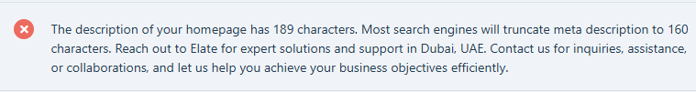

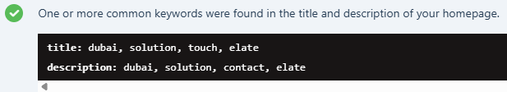


Slide 15
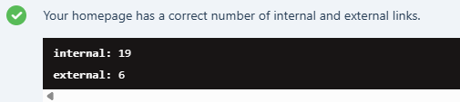

Slide 16
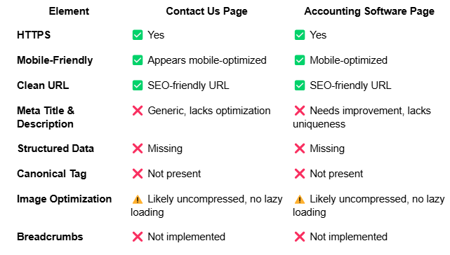
Technical SEO Report.
Analyzed Pages:
Contact Us
Accounting Software

Slide 17
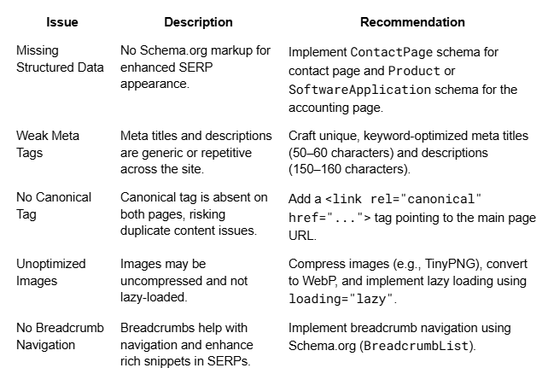
Identified Issues with actionable recommendations.

Slide 18
Five Best Practices to Improve Speed & Web Performance
Enable Compression
Use GZIP or Brotli compression to reduce server response payload size.
Leverage Browser Caching
Define cache-control headers to store static assets in users' browsers.
Minify CSS, JS, HTML
Remove unnecessary whitespace and comments to reduce file size.

Slide 19
4. Use a CDN
Deliver assets from edge locations near users for faster global load times.
5. Optimize Critical Rendering Path
Defer non-essential JavaScript, preload fonts, and prioritize above-the-fold content for quicker first render.

Slide 20
Content Strategy Plan.
Objectives:
Drive qualified traffic to service pages
Build topical authority in business & finance tech
Rank for high-intent, location-specific keywords
Support SEO with blog content, guides, FAQs, and lead magnets

Slide 21
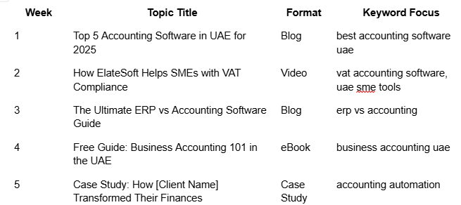
Suggestions

Slide 22
SEO Strategy and recommendations document.
Keyword strategy
Conduct deep keyword research targeting.
Group keywords into topical clusters around core products
Technical SEO enhancements
Improve core web vitals.
Implement structured data.
Canonicalization.
Ensure Mobile friendliness.
Fix crawl errors.

Slide 23
On page optimization.
Update Meta Titles & Descriptions for all service pages.
Use Proper Header Hierarchy (H1 > H2 > H3).
Internal Linking Strategy.
Image Optimization.
Content Strategy
Create SEO-Driven Blog Content (2–4 posts/month).
Develop Industry-Specific Landing Pages .
Add FAQ Sections with schema markup to product pages.
Publish Case Studies & Success Stories regularly.
Create Downloadable Assets like guides, checklists, and whitepapers.

Slide 24
OFF Page SEO/ Link Building
Local SEO Citations.
High-Quality Guest Posting.
Linkable Content Assets.
Engage with Industry Communities.
Local SEO focus
Optimize Google Business Profile
Use consistent NAP (Name, Address, Phone) across platforms
Add customer reviews & Q&A to your Google listing
Target local keywords with geo-modifiers (e.g., “HR software in Abu Dhabi”)

Slide 25
Analytics, Monitoring & KPIs
Tools to Use:
Google Analytics 4 (GA4)
Google Search Console
Ahrefs / SEMrush / Ubersuggest
PageSpeed Insights / GTmetrix
Key KPIs to Track:
Organic Traffic (Sessions & Users)
Keyword Rankings (Top 10, Top 3)
Click-through Rate (CTR) from Google SERPs
Bounce Rate & Time on Page
Leads / Conversions from organic traffic

Slide 26
THANK YOU.

